Slide 1



The Smart Mobile Messenger.

Slide 2

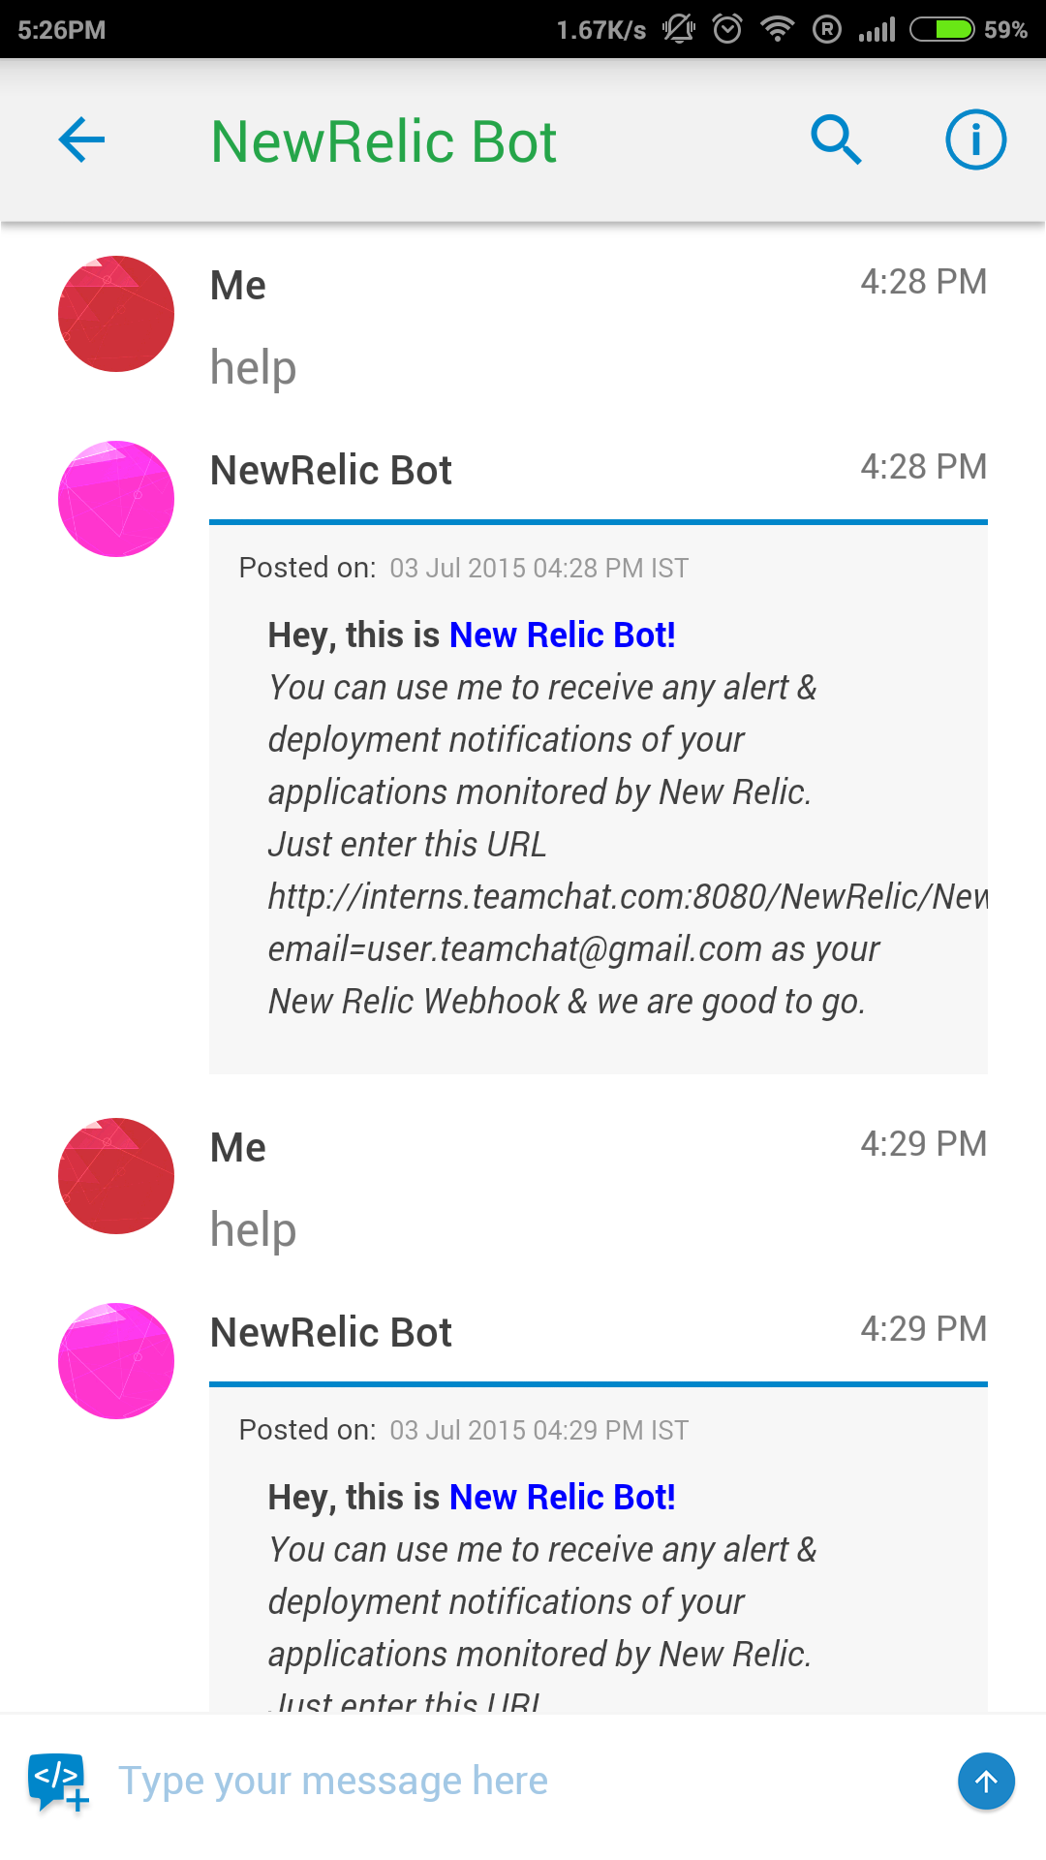

Teamchat App introduces "NewRelic" integration
Now with "New Relic" integration on Teamchat stay updated to your New Relic alerts and deployment notification.
Entering the keyword "help post a chatlet.
A token/pin is generated after sign in.

Slide 3
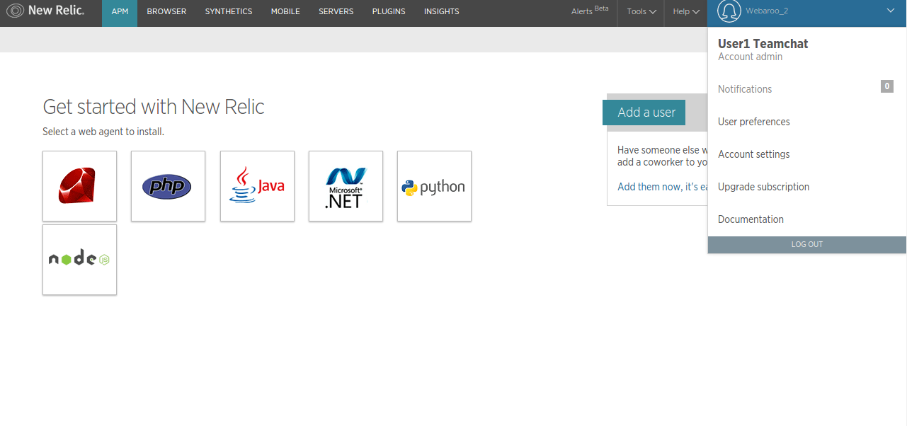
Setting Up Webhook
Click on Account Settings

Slide 4
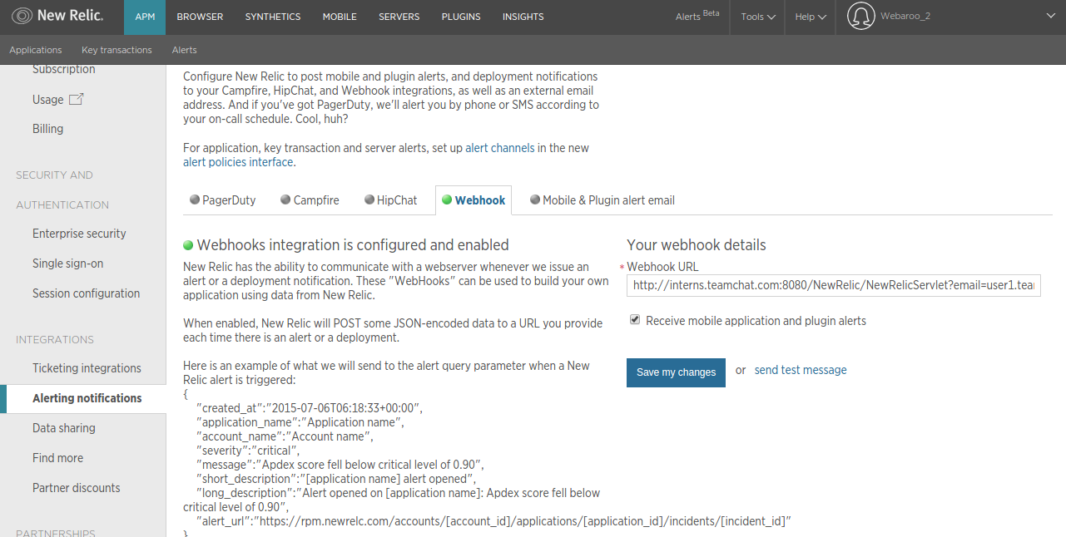
Setting Up Webhook
Step 4. Click on this link to
set up alert channels
Step 1. Click on Alert notifications
Step 2. Click on Webhook
Step 3. Paste the copied link in the bo and click on Save changes.

Slide 5
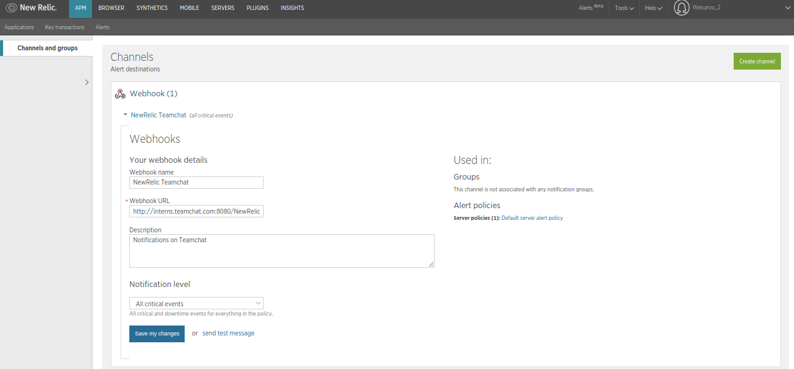
Setting Up Webhook
Click on webhook and fill in the details. Now you are ready to GO.

Slide 6
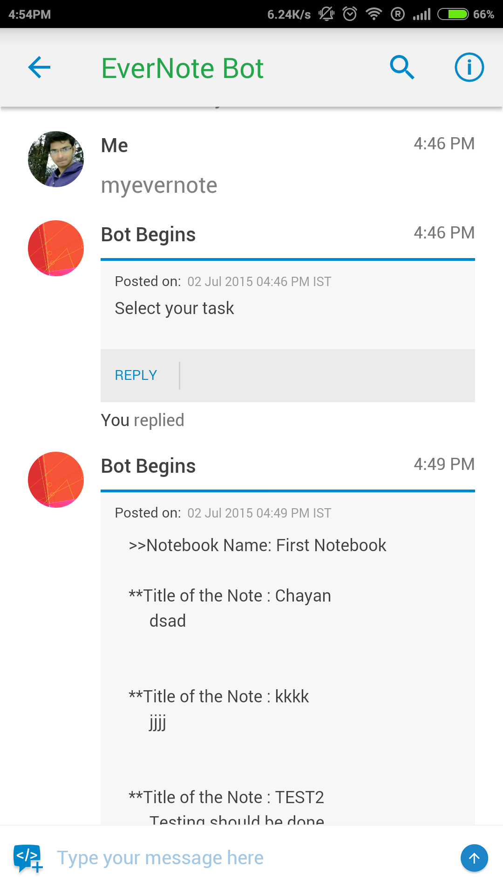
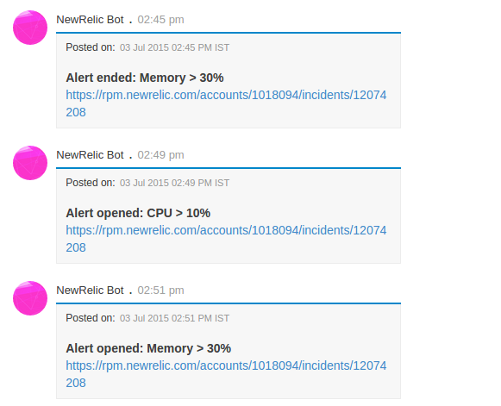
View notes on Evernote

Slide 7

Thank You

